Slide 1
Chapter 3: Classes and Data Abstraction
Outline
3.1 Introduction
3.2 Implementing a Time Abstract Data Type with a Class
3.3 Class Scope and Accessing Class Members
3.4 Separating Interface from Implementation
3.5 Controlling Access to Members
3.6 Access Functions and Utility Functions
Objectives
In this chapter, you will learn:
  To understand the software engineering concepts of en­capsulation and data hiding.
  To understand the notions of data abstraction and ab­stract data types (ADTs).
  To be able to create C++ ADTs, namely classes.

Slide 2
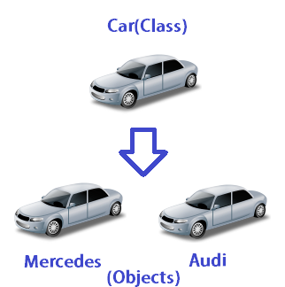
3.1 Introduction
Object-oriented programming (OOP)
  Encapsulates data (attributes) and functions (behavior) into packages called classes
  Data and functions closely related
Information hiding
  Implementation details are hidden within the classes themselves
Unit of C++ programming: the class
  A class is like a blueprint – reusable
  Objects are instantiated (created) from the class
  For example, a house is an instance of a “blueprint class”
  C programmers concentrate on functions

Slide 3
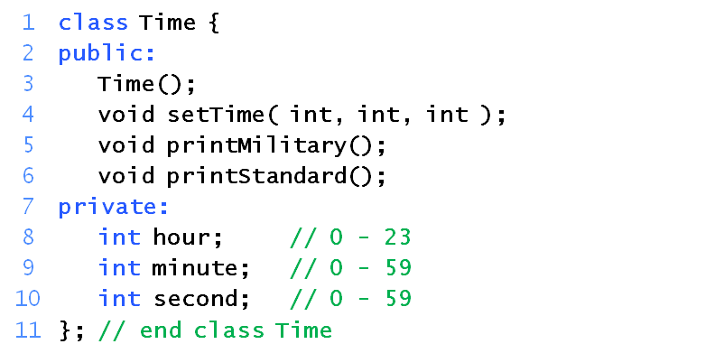
3.2 Implementing a Time Abstract Data Type with a Class
Classes
  Model objects that have attributes (data members) and behaviors (member functions)
  Defined using keyword class
Public: and Private: are member-access specifiers.
setTime, printMilitary, and printStandard are member functions.
Time is the constructor.
hour, minute, and second are data members.

Slide 4
3.2 Implementing a Time Abstract Data Type with a Class (II)
Format
  Body delineated with braces ({ and })
  Class definition terminates with a semicolon(分号)
Access Authority (访问权限)
Public - accessible wherever the program has access to an object of class Time
Private - accessible only to member functions of the class
Protected - discussed later in the course

Slide 5
3.2 Implementing a Time Abstract Data Type with a Class (III)
Constructor（构造函数：创建对象本身）
  Special member function that initializes data members of a class object
  Constructors cannot return values
  Same name as the class
Definitions
  Once class defined, can be used as a data type
Time sunset, // object of type Time
arrayOfTimes[ 5 ], // array of Time objects
*pointerToTime, // pointer to a Time object
&dinnerTime = sunset; // reference to a Time object
Note: The class name becomes the new type specifier.

Slide 6
3.2 Implementing a Time Abstract Data Type with a Class (IV)
Binary scope resolution operator (::)
  Specifies which class owns the member function
  Different classes can have the same name for member functions
Format for definition class member functions
ReturnType ClassName::MemberFunctionName( ){
…
}

Slide 7
3.2 Implementing a Time Abstract Data Type with a Class (V)
If member function is defined inside the class
  Scope resolution operator and class name are not needed
  Defining a function outside a class does not change it being public or private
Classes encourage software reuse
  Inheritance allows new classes to be derived from old ones
In following program
  Time constructor initializes the data members to 0
    Ensures that the object is in a consistent state when it is created

Slide 8
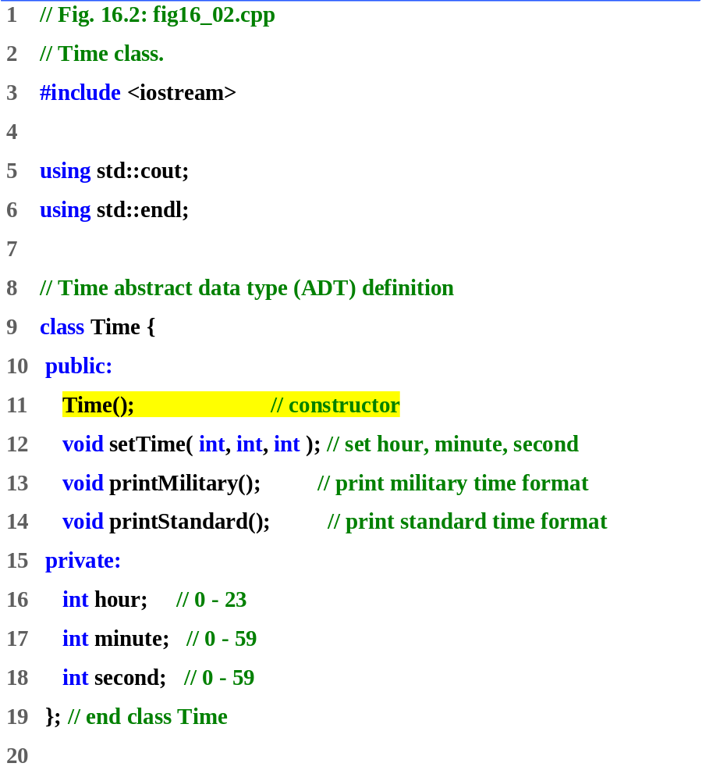

Slide 9
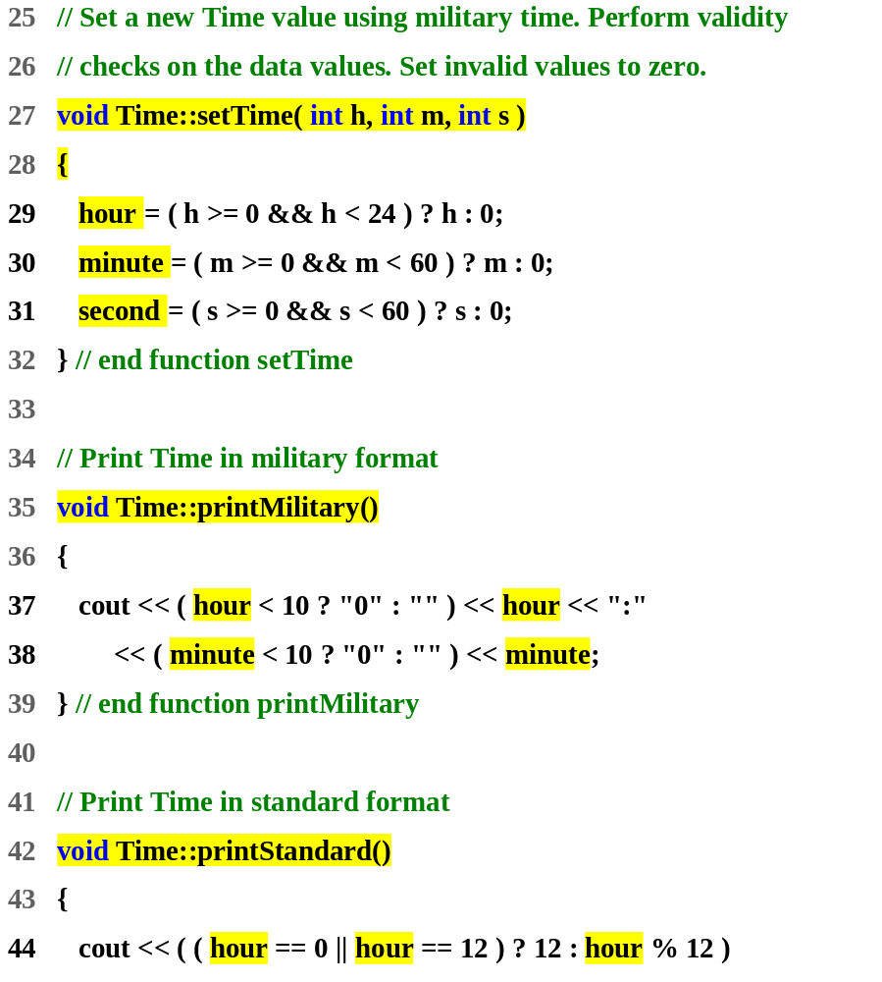

Slide 10
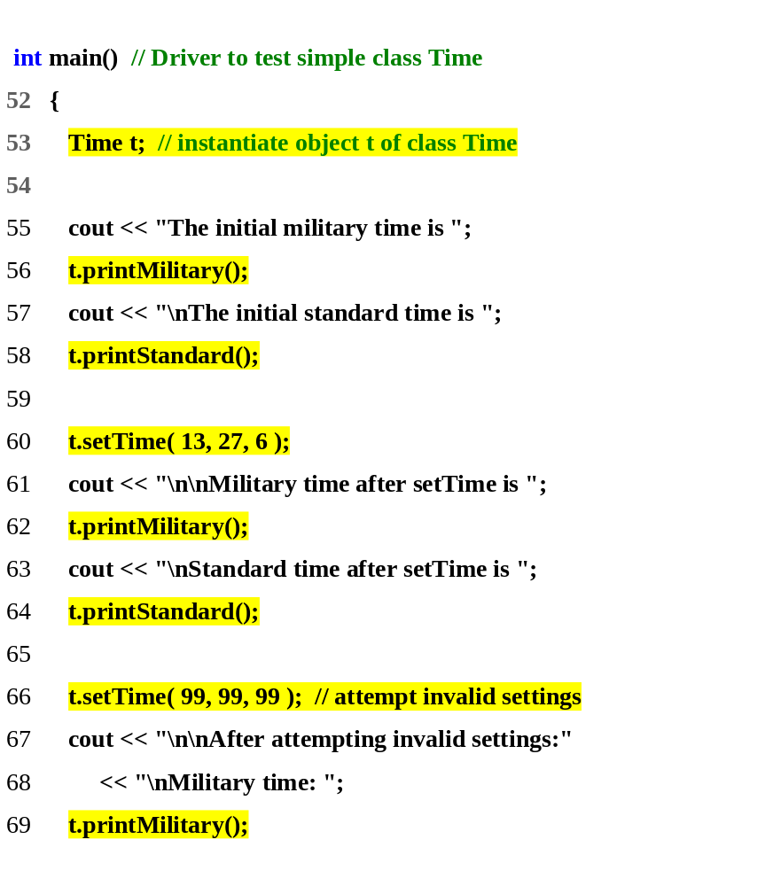
Program Output
The initial military time is 00:00
The initial standard time is 12:00:00 AM
Military time after setTime is 13:27
Standard time after setTime is 1:27:06 PM
After attempting invalid settings:
Military time: 00:00
Standard time: 12:00:00 AM

Slide 11
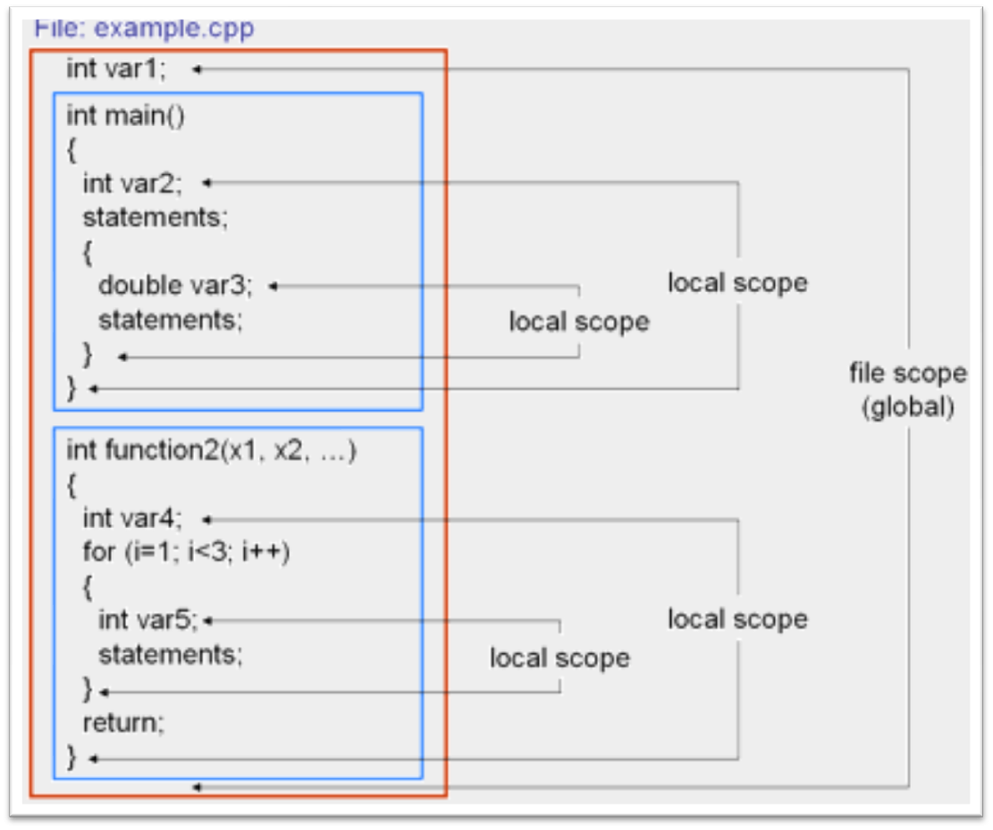
3.3 Class Scope and Accessing Class Members
Class scope
  Data members and member functions
File scope
  Nonmember functions
Function scope
  Variables defined in member functions, destroyed after function completes
Inside a scope
  Members accessible by all member functions
  Referenced by name
function scope
local scope
file scope
function scope
local scope

Slide 12
3.3 Class Scope and Accessing Class Members (II)
Outside a scope
  Use handles
    An object name, a reference to an object or a pointer to an object
Accessing class members
  Same as structs
  Dot (.) for objects and arrow (->) for pointers
  Example: t.hour is the hour element of t
  TimePtr->hour is the hour element

Slide 13
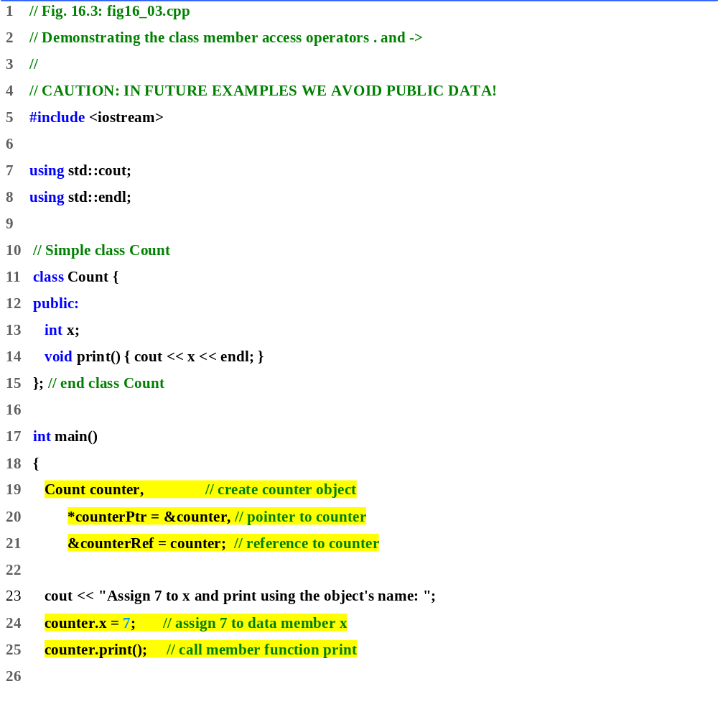
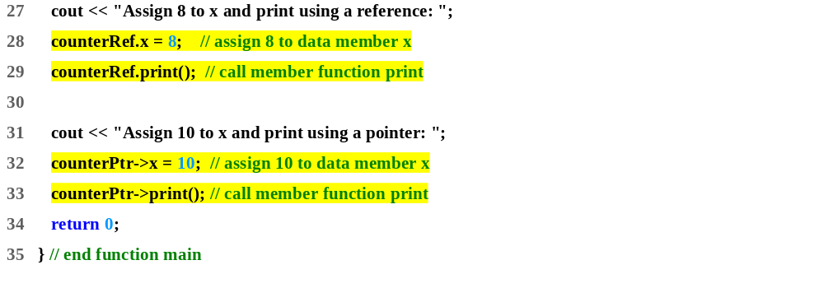
fig16_03.cpp
Program Output
Assign 7 to x and print using the object's name: 7
Assign 8 to x and print using a reference: 8
Assign 10 to x and print using a pointer: 10

Slide 14
3.4 Separating Interface from Implementation
Separating interface from implementation
  Easier to modify programs
  C++ programs can be split into
Header files – contains class definitions and function prototypes
Source-code files – contains member function definitions
Program Outline:
  Using the same Time class as before, create a header file
  Create a source code file
    Load the header file to get the class definitions
    Define the member functions of the class

Slide 15
3.4 Separating Interface from Implementation
将程序分成多个文件的理由：
  1）将相关类和函数放在一个特定的文件中，可通过对不同的文件进行单独编写、编译、连接，来避免了重复工作。
  2）程序管理更容易。
类的声明---类声明文件（*.h）
类成员的实现---类实现文件（*.cpp）
主函数---类的使用文件（*.cpp）
  3）充分利用了类的封装特性。在对程序进行调试修改时，
  只需对某一个类的定义和实现进行操作。

Slide 16
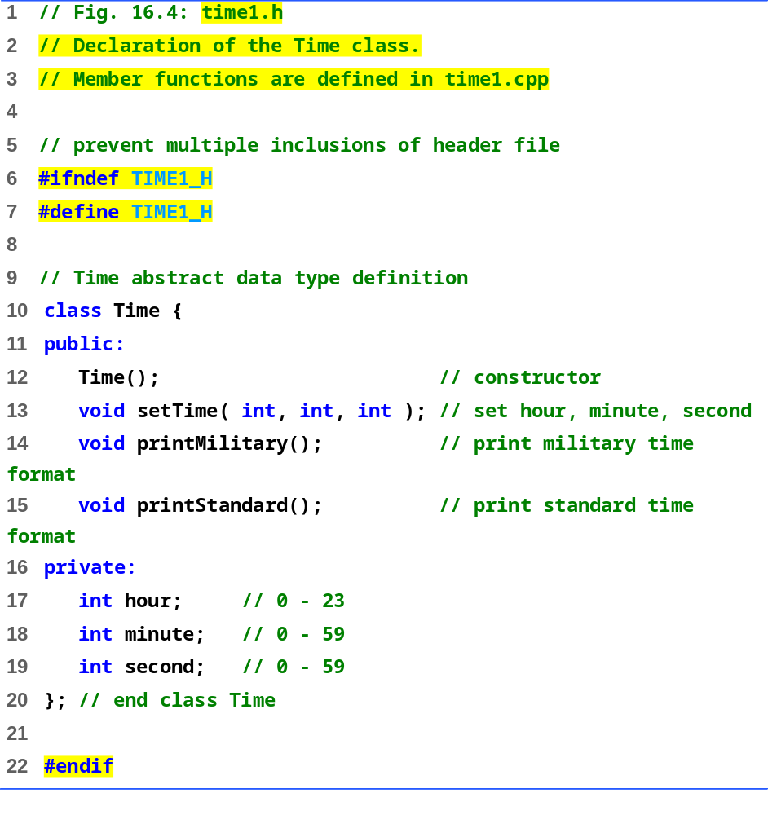
time1.h
使用条件预处理指令来避免头文件被重复包含

Slide 17
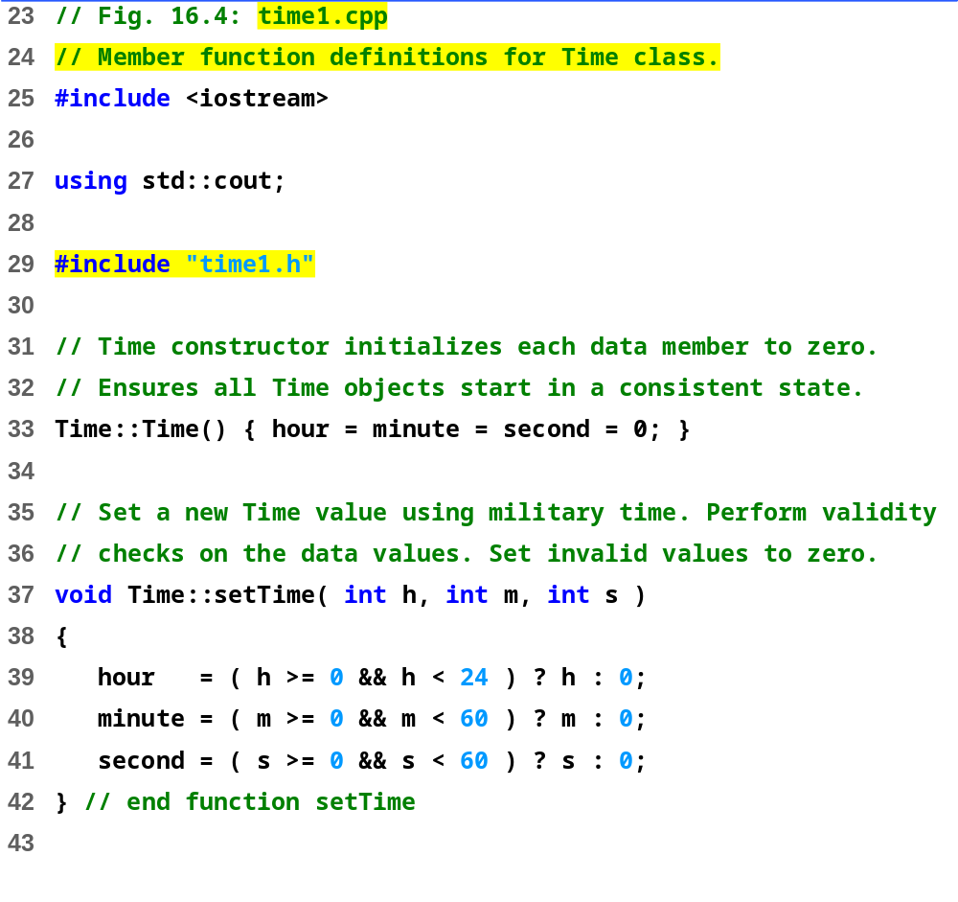
time1.cpp (Part 1 of 2)

Slide 18
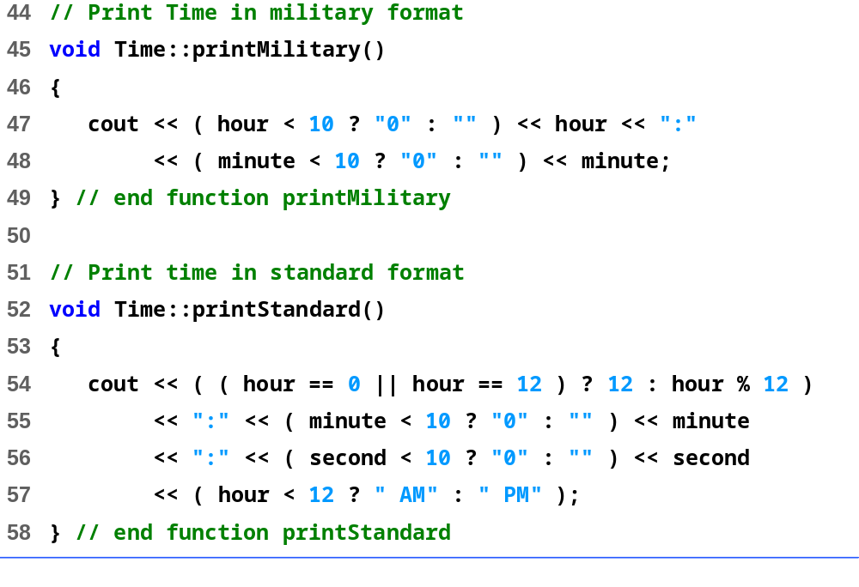
time1.cpp (Part 2 of 2)

Slide 19
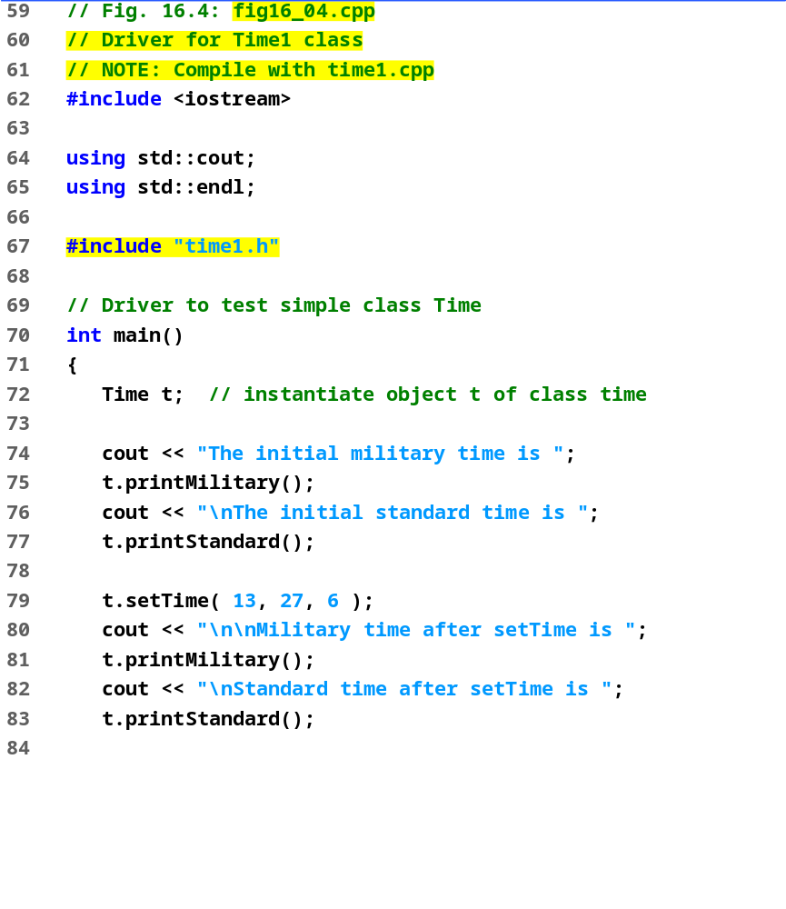
fig16_04.cpp (Part 1 of 2)

Slide 20
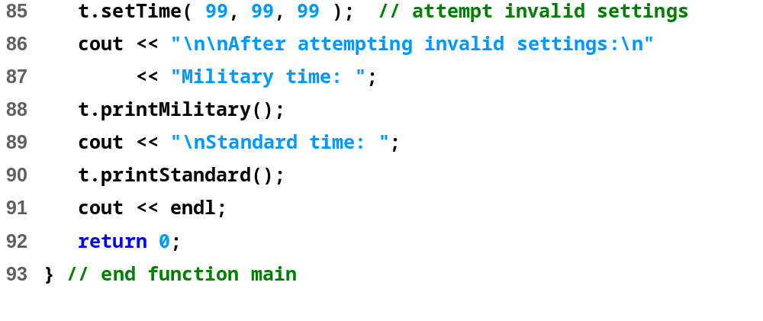
fig16_04.cpp (Part 2 of 2)
The initial military time is 00:00
The initial standard time is 12:00:00 AM
Military time after setTime is 13:27
Standard time after setTime is 1:27:06 PM
After attempting invalid settings:
Military time: 00:00
Standard time: 12:00:00 AM
Program Output

Slide 21
time1.cpp
#include “time1.h”
fig16_04.cpp
#include “time1.h”
time1.h
编译
编译
time1.obj
Fig16_04.obj
连接
可执行程序Fig16_04.exe

Slide 22
3.5 Controlling Access to Members
Purpose of public
  Give clients a view of the services the class provides (interface)
Purpose of private
  Default setting
  Hide details of how the class accomplishes its tasks (implementation)
  Private members only accessible through the public interface using public member functions

Slide 23
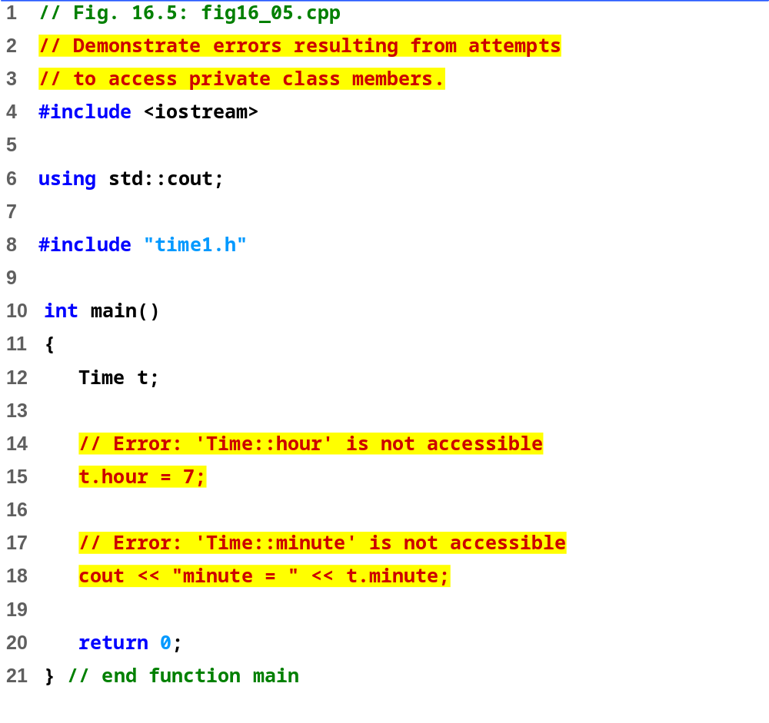
fig16_05.cpp

Slide 24
Program Output
Borland C++ command-line compiler error messages
Time1.cpp:
Fig16_05.cpp:
Error E2247 Fig16_05.cpp 15:
'Time::hour' is not accessible in function main()
Error E2247 Fig16_05.cpp 18:
'Time::minute' is not accessible in function main()
*** 2 errors in Compile ***
Microsoft Visual C++ compiler error messages
Compiling...
Fig16_05.cpp
D:\Fig16_05.cpp(15) : error C2248: 'hour' : cannot access private
member declared in class 'Time'
D:\Fig16_05\time1.h(18) : see declaration of 'hour'
D:\Fig16_05.cpp(18) : error C2248: 'minute' : cannot access private
member declared in class 'Time'
D:\time1.h(19) : see declaration of 'minute'
Error executing cl.exe.
test.exe - 2 error(s), 0 warning(s)

Slide 25
3.6 Access Functions and Utility Functions
Utility functions
  private functions that support the operation of public functions
  Not intended to be used directly by clients
Access functions
  public functions that read/display data or check conditions
  For a container, it could call the isEmpty function
Next
  Program to take in monthly sales and output the total
  Implementation not shown, only access functions

Slide 26
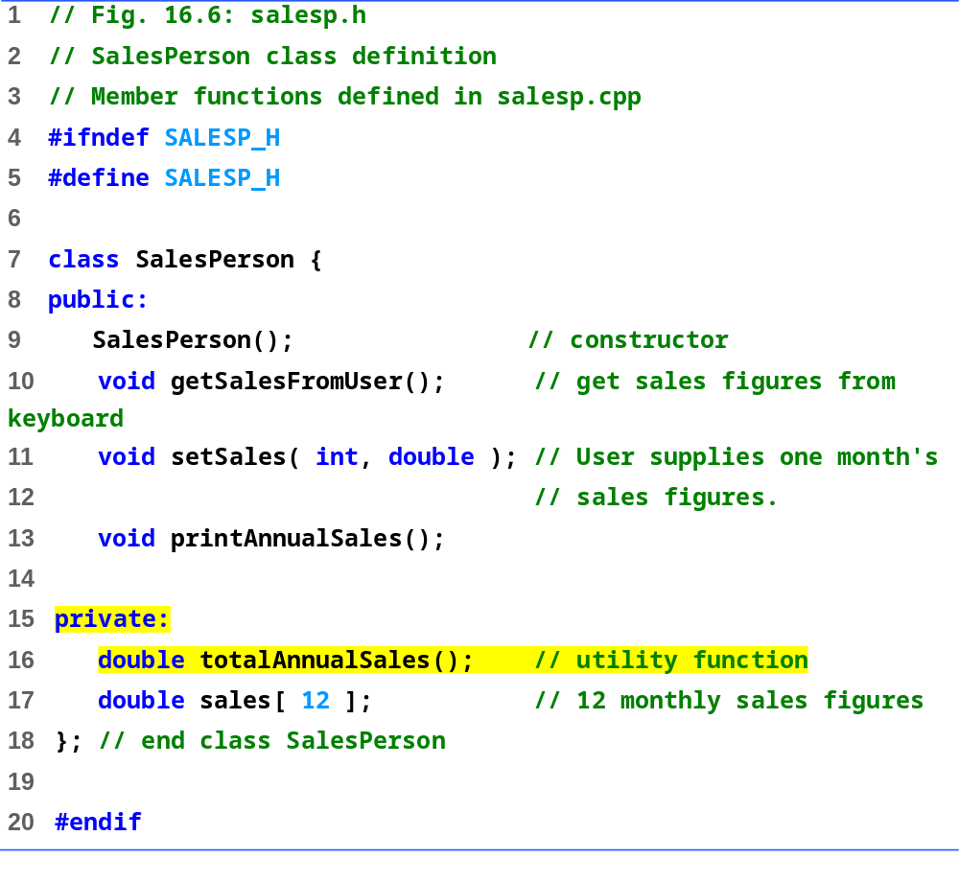
salesp.h

Slide 27
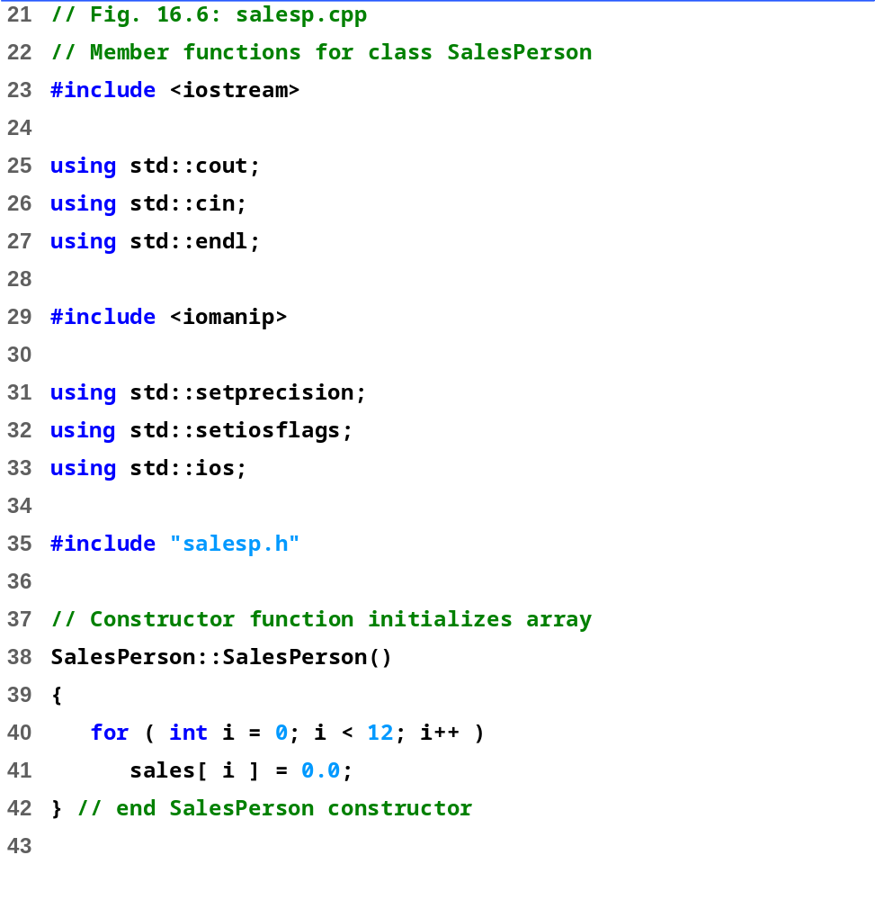
salesp.cpp (Part 1 of 3)

Slide 28
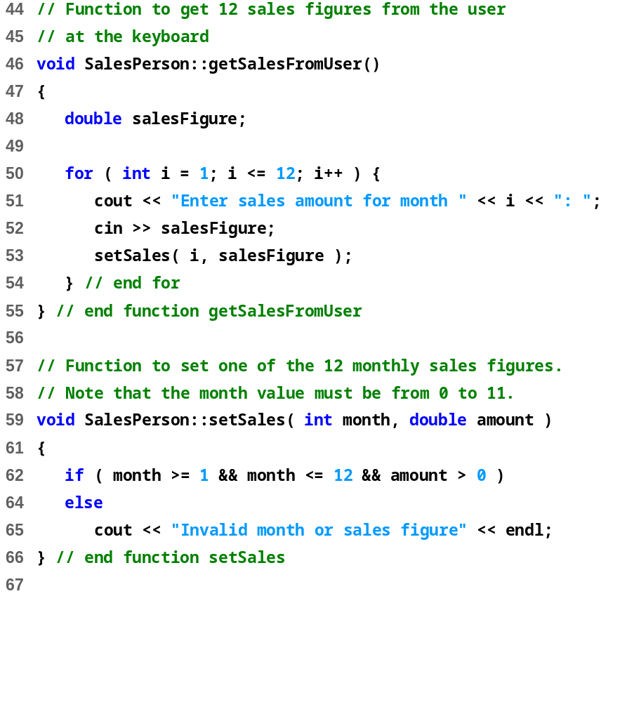
salesp.cpp (Part 2 of 3)

Slide 29
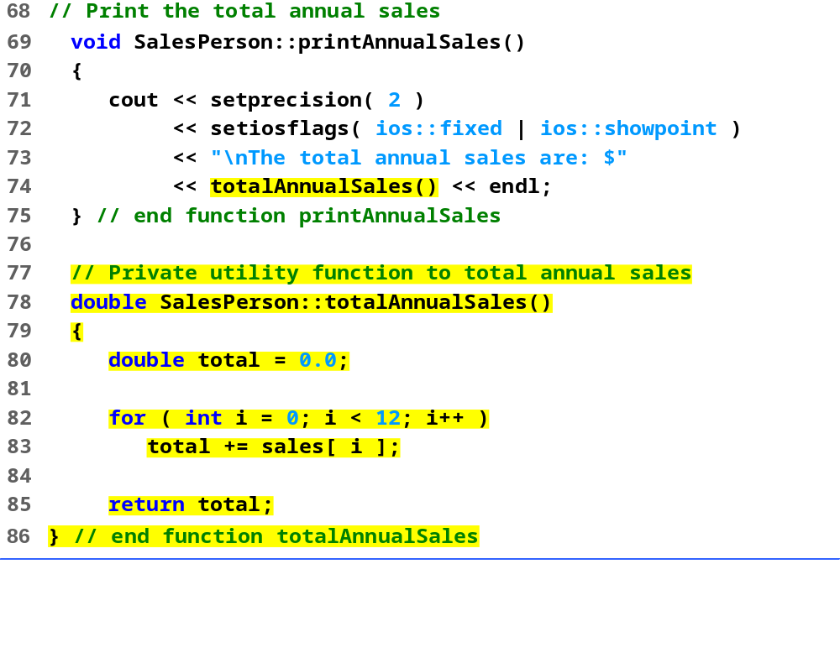
salesp.cpp (Part 3 of 3)

Slide 30
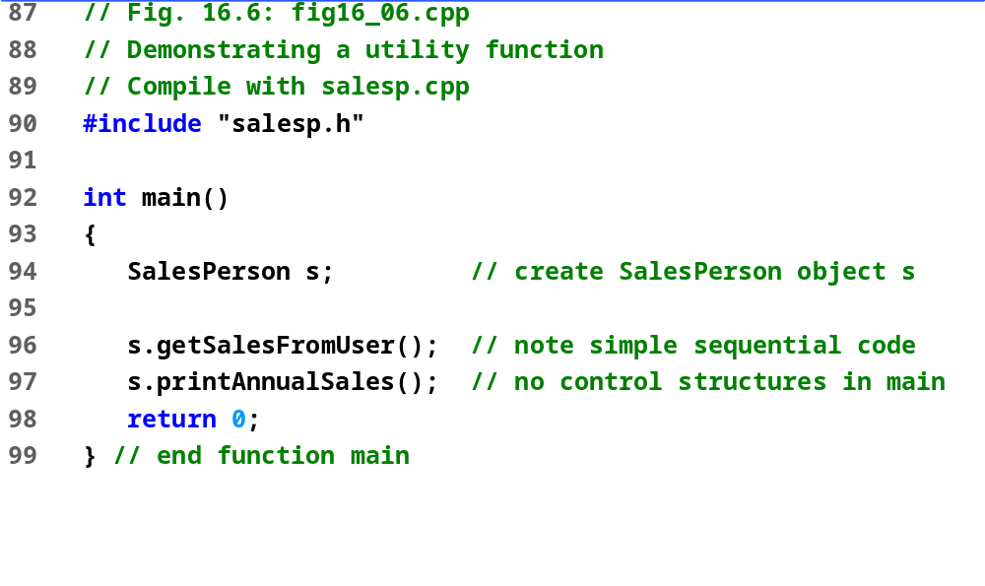
fig16_06.cpp
Enter sales amount for month 1: 5314.76
Enter sales amount for month 2: 4292.38
Enter sales amount for month 3: 4589.83
Enter sales amount for month 4: 5534.03
Enter sales amount for month 5: 4376.34
Enter sales amount for month 6: 5698.45
Enter sales amount for month 7: 4439.22
Enter sales amount for month 8: 5893.57
Enter sales amount for month 9: 4909.67
Enter sales amount for month 10: 5123.45
Enter sales amount for month 11: 4024.97
Enter sales amount for month 12: 5923.92
The total annual sales are: $60120.59
Program Output

Slide 31
Thank you !

